Slide 1
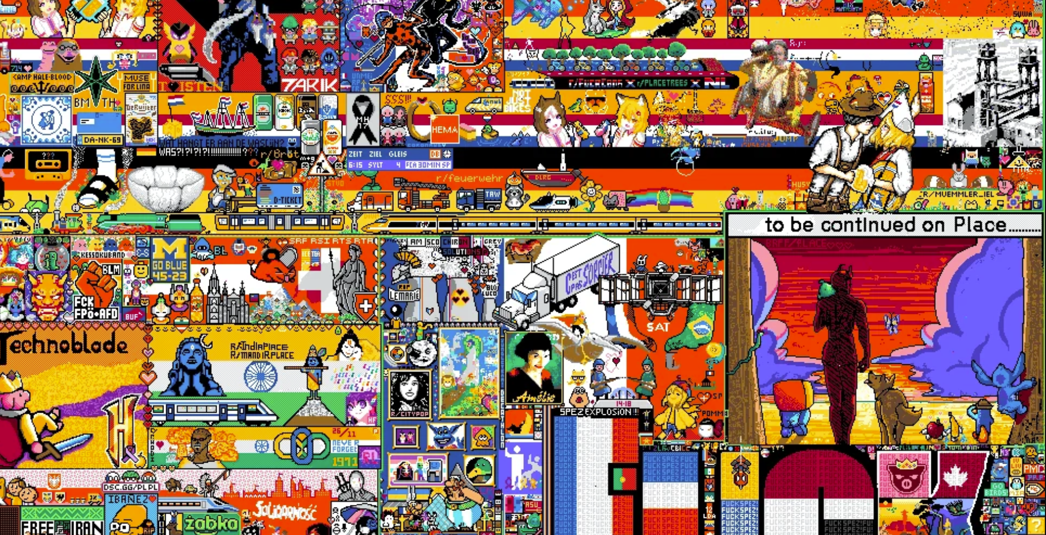
r/place Analysis V2
Nirbhay Singh Naruka, Viswadatta Chinta, Prit shah, Pranav Upadhyaya

Slide 2
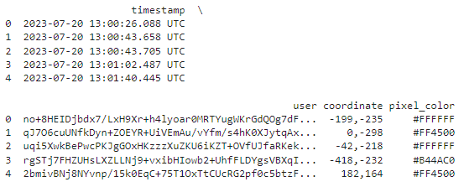
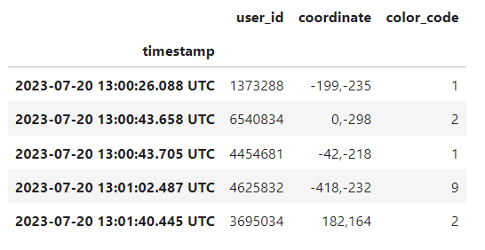
Data Preprocessing
Mapped color coding from a range of 0 - 31.
Replaced unique `user_id` strings with numerical IDs, starting from 1.
Utilized timestamp as an index for enhanced day-based navigation.
Reduced file from 13.4 GB to 2.39GB
Notes:
Mapped the color coding from 0 - 31
Replaced the unique user_id string with numbers starting from 1 and made the timestamp as index for better navigation based on days.
This reduced our parquet files from 13.4 GB to 2.39GB which reduced the processing time for all analysis by a considerable amount.
- Emphasize how reducing file size and improving data structure can significantly enhance processing efficiency and speed.
- how mapping the color coding to a limited range (0-31) reduced the complexity and size of the data.
- User ID Replacement: Explain the decision to replace verbose `user_id` strings with sequential numbers, simplifying data handling and reducing space.
- Timestamp Indexing: Highlight how using timestamps as indexes improved the navigability of the dataset, making it easier to perform time-based analyses.

Slide 3
03
Human vs Bot Interaction
01
Bot Analysis
Admins and Bots Identification
02
Visualizing humans and bots interaction with r/place
Analyzing the trends of bots
How we Identified Admins and bots?

Slide 4
Reddit Admins Identification
Identified Admins based on pixel inputs
Circle arguments {X: 425, Y: 441, R: 2}
Rectangle arguments “169,463,170,464”
There were 56 unique admins with such pixel parameters
They have the ability to place circles and rectangle in the canvas using admin tools.
Notes:
Noticed a few pixel placements having more than 2 arguments.
Circle arguments
Rectangle arguments
Such as Circle , rectangles and categorized them as admins
As only they have the ability to placed circles and rectangle in the canvas to overwrite offensive artwork.

Slide 5
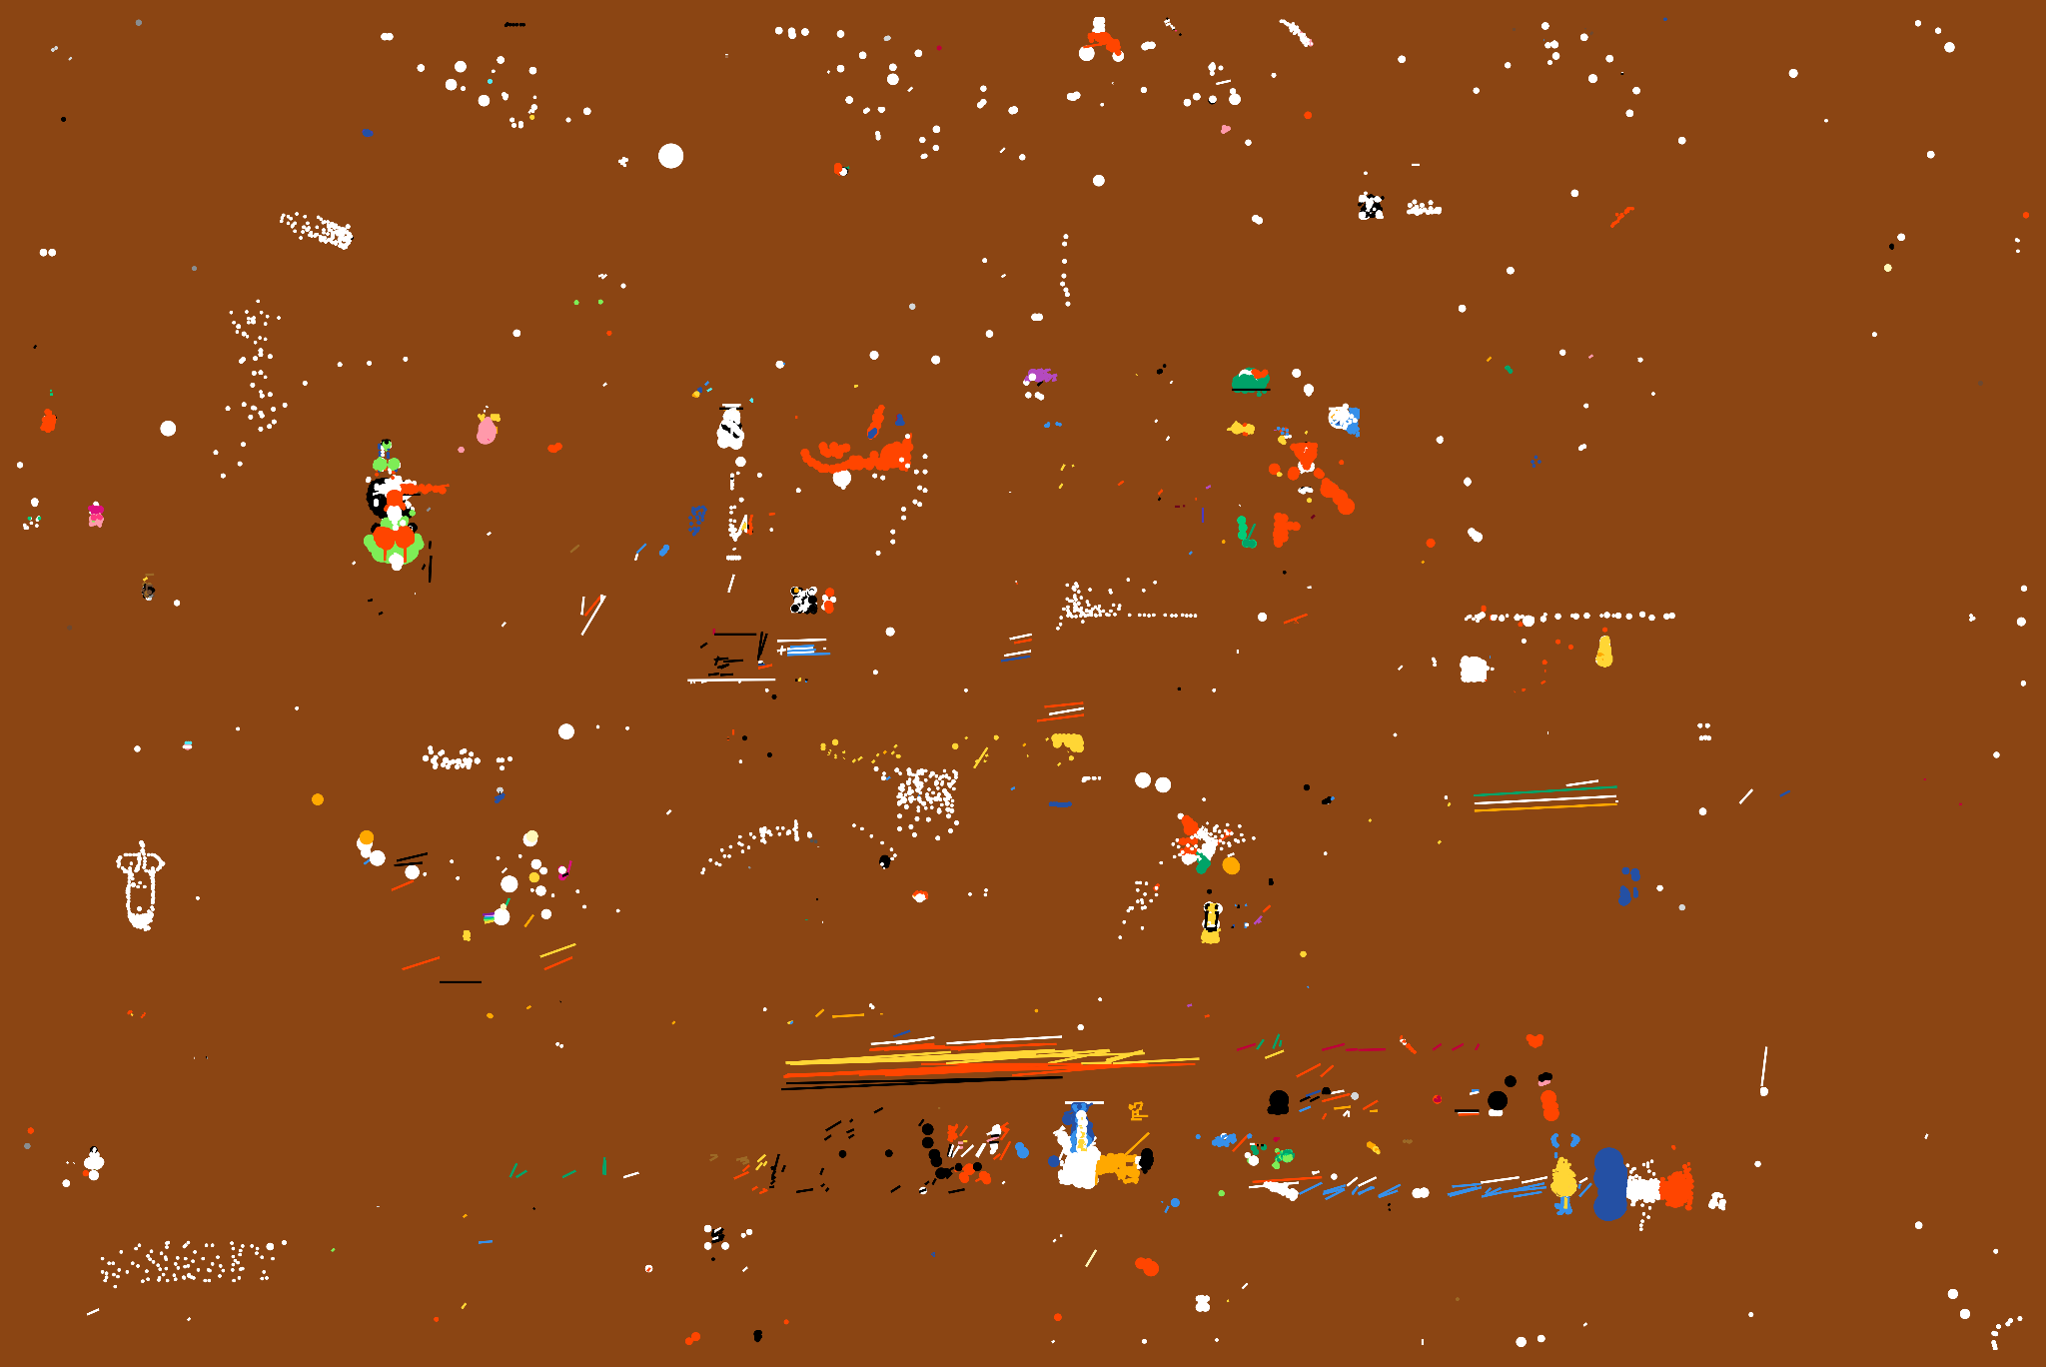
Admin Interaction

Slide 6

Math for Reddit Bots Identification
We considered
Max pixels per hour = 60/4 = 15 pixels
Total pixels = 12(Hours active) x 15(pixels per hour) x 5 (days)
= 900
Considered 450 pixels as human limit and anything above that is most likely a bot.
Notes:
Based on more research from previous year r/place events we came to know about passionate redditors who placed more than 300-400 pixels throughout the event.
Hence, We considered
Max pixels per hour = 60/4 = 15 pixels
Total pixels = 12(Hours active) x 15(pixels per hour) x 5 (days)
= 900.
Considered 450 pixels as human limit and anything above that is most likely a bot.
There could have been verified bots as well as unverified bots could only place 360 pixels throughout the event.

Slide 7
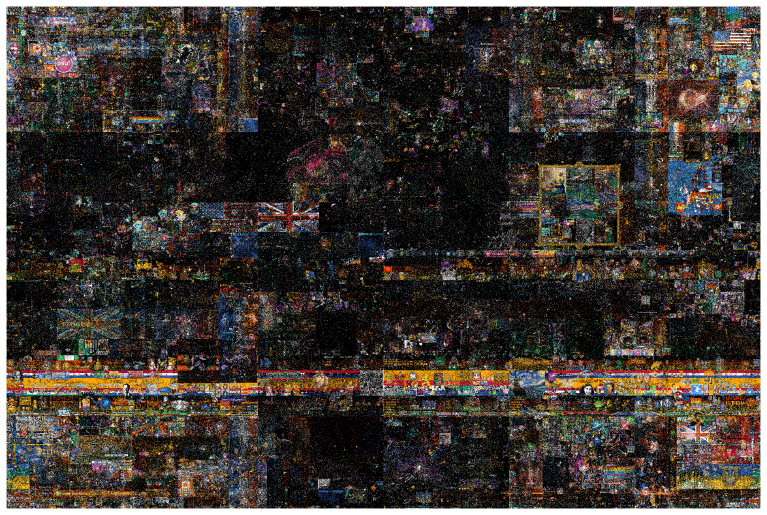
Final Bot Image
Notes:
Reddit's r/Place event has ended where the mods behind it have changed every color to white. Apparently a huge chunk of what was going on was bots, because many areas instantly turned white as all the programs running to keep places intact ended up instantly turning them white instead! Now the entire thing is slowly being wiped out as people have only one choice remaining in their color picking. This is a canvas of the timestamps of bot placements. Since it is of the last day, it is mostly white

Slide 8
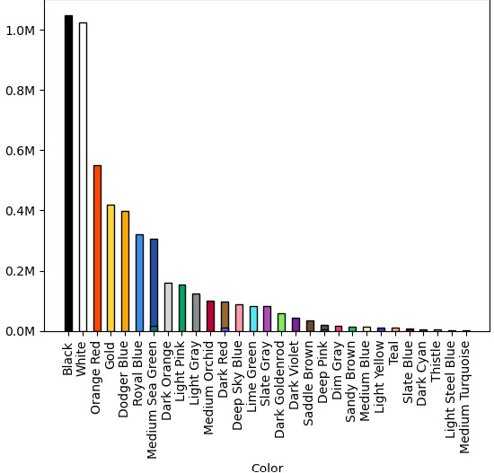
Most used colors by bots
Notes:
Reddit's r/Place event has ended where the mods behind it have changed every color to white. Apparently a huge chunk of what was going on was bots, because many areas instantly turned white as all the programs running to keep places intact ended up instantly turning them white instead! Now the entire thing is slowly being wiped out as people have only one choice remaining in their color picking. This is a canvas of the timestamps of bot placements. Since it is of the last day, it is mostly white

Slide 9
THANKS

